Slide 1
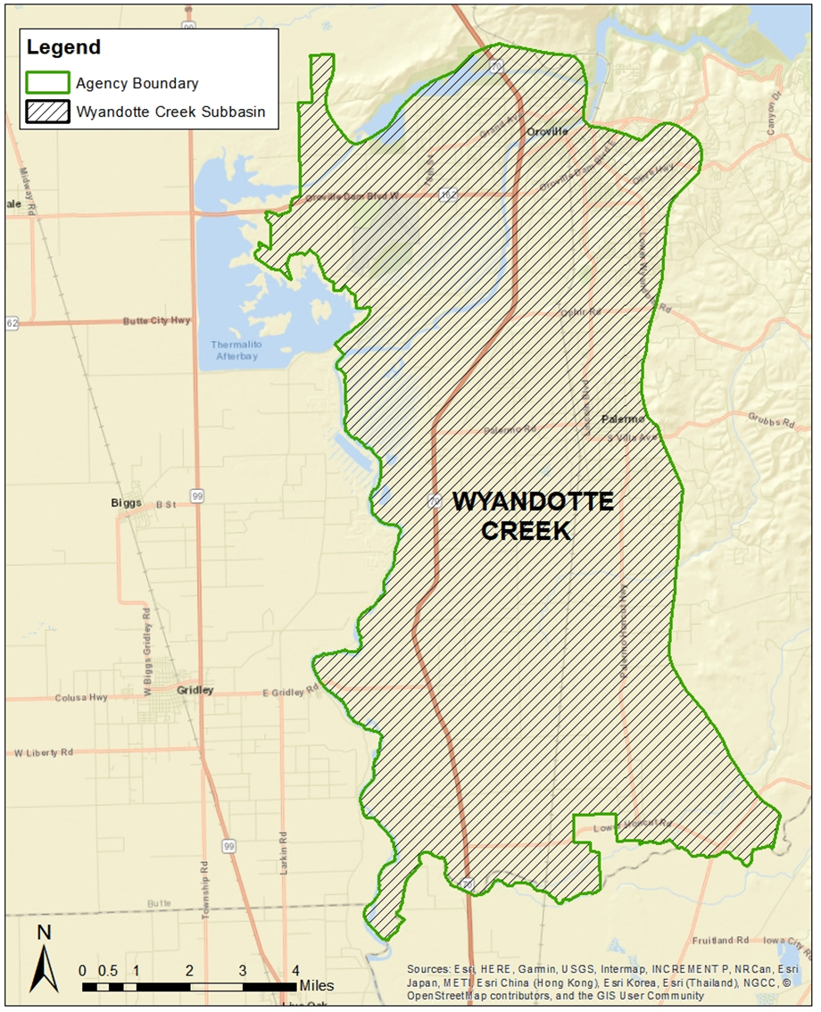

Groundwater Sustainability Plan Status
April 1, 2021

Slide 2
Groundwater Sustainability Plan Status
Groundwater Sustainability Plan
1. Administrative Information
  §354.4. General Information
  §354.6. Agency Information
  §354.8. Description of Plan Area
  §354.10. Notice & Communication
2. Basin Setting
  §354.14. Hydrogeologic Conceptual Model
  §354.16. Groundwater Conditions
  §354.18. Water Budget
  §354.20. Management Areas
3. Sustainable Management Criteria
  §354.24. Sustainability Goal
  §354.26. Undesirable Results
  §354.28. Minimum Thresholds
  §354.30. Measurable Objectives
4. Monitoring Networks
  §354.34. Monitoring Network
  §354.36. Representative Monitoring
  §354.38. Assessment & Improvement
  §354.40. Reporting Monitoring Data to the Department
5. Projects and Management Actions
  §354.44. Projects & Management Actions

Slide 3
Groundwater Sustainability Plan Status
Schedule
  Basin Setting Chapter – draft completed
    Groundwater Dependent Ecosystems
  Sustainable Management Criteria & Representative Monitoring Network Chapters
    April – 30 day public comment period
    May – Water Advisory Committee Review
    June – Board consideration approve the final draft

Slide 4
Groundwater Sustainability Plan Status
Schedule
  Projects and Management Actions
    Current - Solicitation of potential projects and management actions
    May – Review by Water Advisory Committee
    May – Status provided to the Board
    June – Board Public Workshop meeting & 30-day public comment period
    July – Review of comments by Water Advisory Committee
    July/August – Board consideration to approve final draft

Slide 5
Groundwater Sustainability Plan Status
Schedule
  Implementation Chapter
    May – Water Advisory Committee discuss implementation costs and approach
    June – 30-day public comment period on the draft Implementation chapter
    July – Water Advisory Committee review of public comments and recommendation to the Board
    July/August – Board consideration to approve final draft

Slide 6
Groundwater Sustainability Plan Status
Schedule
Draft Groundwater Sustainability Plan (complete)
September – 60 day public comment period
November – Review of comments by the Water Advisory Committee and recommendations to the Board
Groundwater Sustainability Plan Approval & Implementation
December – Board hearings and approval
January – GSP Submission
January – Groundwater Sustainability Plan Implementation Grant

Slide 7
Groundwater Sustainability Plan Status
Thank you

