Slide 1
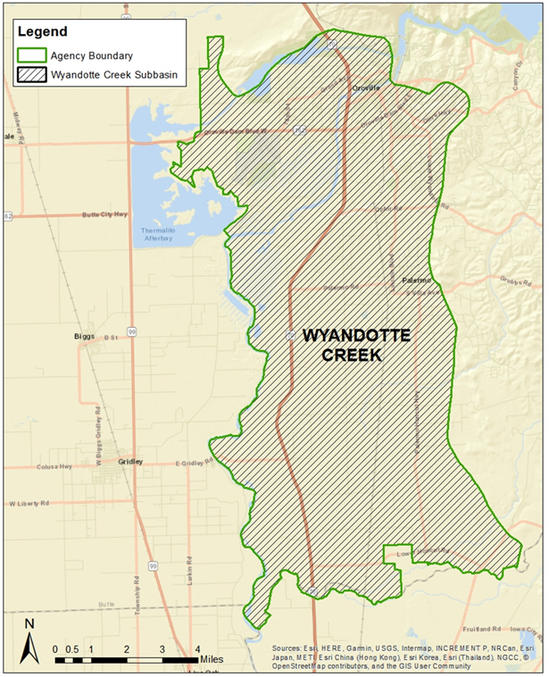
Groundwater Sustainability Plan Status
Wyandotte Creek Subbasin
December 16, 2020

Slide 2
Groundwater Sustainability Plan Status
Groundwater Sustainability Plan
1. Administrative Information
§354.4. General Information
§354.6. Agency Information
§354.8. Description of Plan Area
§354.10. Notice & Communication
2. Basin Setting
§354.14. Hydrogeologic Conceptual Model
§354.16. Groundwater Conditions
§354.18. Water Budget
§354.20. Management Areas
3. Sustainable Management Criteria
§354.24. Sustainability Goal
§354.26. Undesirable Results
§354.28. Minimum Thresholds
§354.30. Measurable Objectives
4. Monitoring Networks
§354.34. Monitoring Network
§354.36. Representative Monitoring
§354.38. Assessment & Improvement
§354.40. Reporting Monitoring Data to the Department
5. Projects and Management Actions
§354.44. Projects & Management Actions

Slide 3
Groundwater Sustainability Plan Status
Overall Timeline
2018-2020 Basin Setting Project (first phase)
2020-2021 GSP Completion Project (final phase)
January 30, 2022 Wyandotte Creek GSP Submitted
IMPLEMENTATION!!!

Slide 4
Groundwater Sustainability Plan Status
Proposition 1 GSP Grant Summary
First Phase “Basin Setting” Project
Grant Administration (Butte County)
Facilitation Services (Consensus Building Institute)
Data Acquisition (AGF - AEM Survey)
Projects and Management Actions (PID Intertie (terminated))
Basin Setting (Davids Engineering)
Final Phase “GSP Completion”
Wyandotte Creek GSP Completion (Multiple tasks) (Geosyntec)
Staff will draft portions of the GSP and administer adoption

Slide 5
Groundwater Sustainability Plan Status
First Phase - Basin Setting & Other Elements
Basin Setting
Hydrogeologic Conceptual Model
Groundwater Conditions
Water Budget
Management Areas (Description and Rationale)
Monitoring
Monitoring Protocol
Monitoring Network
Data and Reporting Standards

Slide 6
Groundwater Sustainability Plan Status
Final Phase – GSP Completion
Sustainable Management Criteria
Sustainability Goal
Undesirable Results
Minimum Thresholds
Measurable Objectives
Projects and Management Actions

Slide 7
Groundwater Sustainability Plan Status
Final Phase – GSP Completion
Administrative Information
Agency Information
Description of Plan Area
Notice and Communication
Interbasin Coordination
Monitoring Networks
Representative Monitoring
Assessment and Improvement
Data Management System

Slide 8
Groundwater Sustainability Plan Status
Schedule
Wyandotte Creek Groundwater Sustainability Plan (v.1)
Basin Setting Chapter – draft completed
Groundwater Dependent Ecosystems
December 2020 to June 2021 (7 months)
Primary emphasis on specific chapters
Sustainable Management Criteria
Representative Monitoring Network
Interbasin Coordination
Projects and Management Actions
Implementation Cost and Funding Options

Slide 9
Groundwater Sustainability Plan Status
Schedule
December 2020 – January 2021
Draft Sustainable Management Criteria
Interbasin Coordination Report
Representative Monitoring Sites
February 2021
Sustainable Management Criteria Draft Document
30 day public comment period
Wyandotte Creek GSA Board Workshop

Slide 10
Groundwater Sustainability Plan Status
Schedule
March 2021
Representative Monitoring Network Draft Document
30 day public comment period
April – May 2021
Recommendations from the WAC on draft
Sustainable Management Criteria
Projects and Management Actions including costs and funding options
Representative Monitoring Network
Data Gaps
Interbasin Coordination

Slide 11
Groundwater Sustainability Plan Status
Schedule
June 2021
Projects and Management Actions Draft Document
30 day public comment period
Interbasin Coordination Report
July 2021
Review the Status of Groundwater Sustainability Plan chapters
Implementation Chapter Draft Document
30 day public review

Slide 12
Groundwater Sustainability Plan Status
Schedule
August 2021
Review the Draft Wyandotte Creek GSP
September 2021
Complete Draft Wyandotte Creek GSP
60 day public comment period
November – December 2021
Board Hearings and Adoption
Implementation …

Slide 13
Groundwater Sustainability Plan Status
Thank you

